Slide 1
Gunpowder River Woody Debris
Gunpowder Road to Grave Run Road
Distance ≈ 2mi. (3.1 k)
March 5, 2011

Slide 2
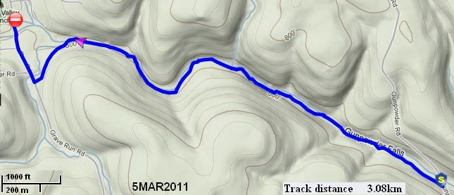
Continuous photo inventory of woody debris
GPS recorded route

Slide 3
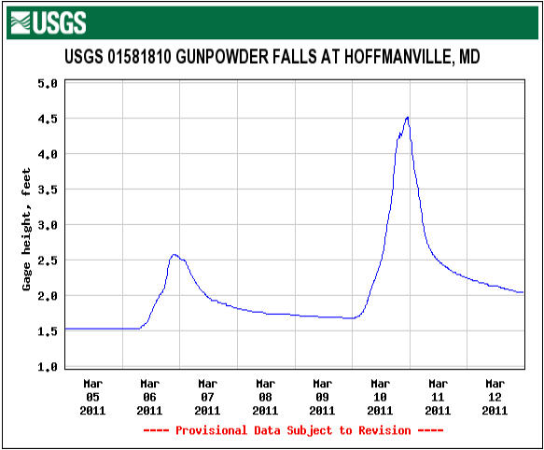
Flow

Slide 4
Station 1 Start

Slide 5
Station 2

Slide 6
Station 3

Slide 7
Station 4

Slide 8
Station 5
Tree pushed from main stream.

Slide 9
Station 6

Slide 10
Station 7

Slide 11
Station 8

Slide 12
Station 9

Slide 13
Station 10

Slide 14
Station 11
May have been cleared or topped prior to deposition.

Slide 15
Station 12
Tree pushed from main stream.

Slide 16
Station 13

Slide 17
Station 14

Slide 18
Station 15
Tree pushed from main stream.

Slide 19
Station 16

Slide 20
Station 17
Tree pushed from main stream.

Slide 21
Station 18
Large tree pushed from main stream.

Slide 22
Station 19
Tree aligned with current flow mid stream.

Slide 23
Station 20a
River-wide Strainer

Slide 24
Station 20b

Slide 25
Station 20c
Tulip Tree (Liriodendron)
Notes:
Low density wood, rots quickly.

Slide 26
Station 20d
River Valley Ranch grill trailer secures top of LWD.

Slide 27
Station 21

Slide 28
Station 22

Slide 29
Station 23

Slide 30
Station 24

Slide 31
Station 25
Undermined root system

Slide 32
Station 26

Slide 33
Station 27

Slide 34
Station 28

Slide 35
Station 29
River Gauge below Grave Run Rd.

Slide 36
Station 30
River Valley Ranch looking upstream.

Slide 37
Station 31
River Valley Ranch looking downstream from Grave Run Rd.

Slide 38
Upstream of Grave Run Rd
River Valley Ranch looking upstream from Grave Run Rd

Slide 39
Below Falls Rd. Example of cleared strainer.
Notes:
This example caused quite a stir a few years ago. Most of the log was left undisturbed. Only enough was removed from the log to allow safe passage. This picture was taken one week after the modification. The area is often the starting point for many paddlers and even tubers. BSA Troop 92 starts a tubing trip here every year. Families often start their float adventures here. More than once experienced paddlers and GBCC members have deterred poorly prepared paddlers from taking unnecessary risks.

Slide 40
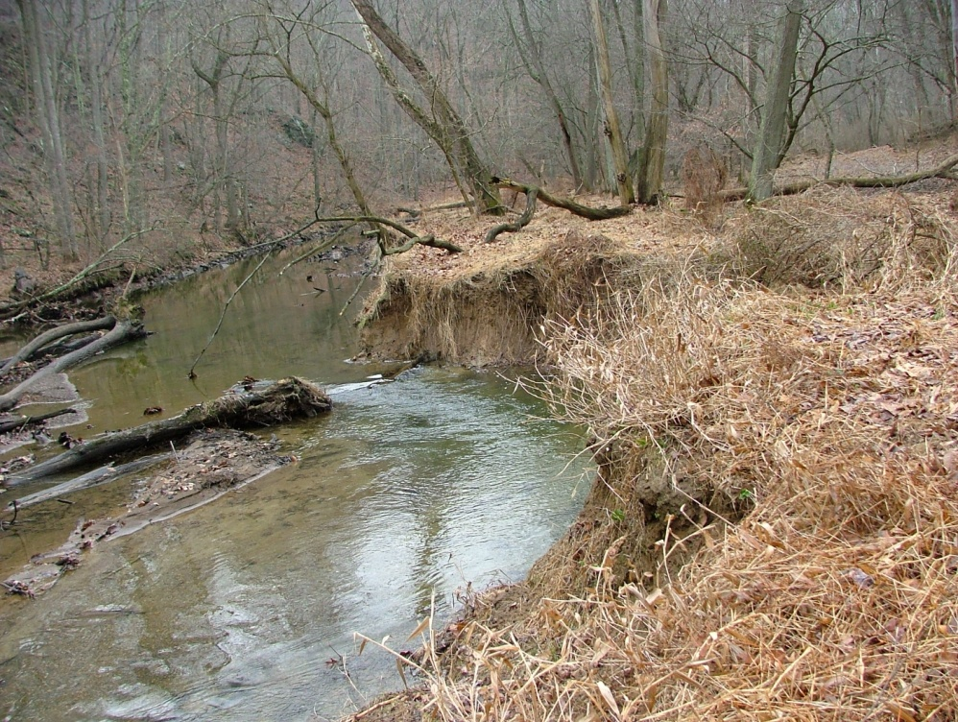
Erosion caused by river wide strainer.
How did not addressing this improve the habitat?
Notes:
The log/strainer that caused this erosion was present for approximately 3 years. The original sneak route was on river right. The route was narrow and complicated passage. While a enjoyable challenge for experienced paddlers it present a danger to the inexperienced. Prior to natural moving the strainer, the bed was bowled by current moving under the log. This did create great place for fish to wait for food. For fishermen the danger was slipping into the bowl and becoming entrapped under the log. The tree seen is not the original.

Slide 41
Log Jam near Big Falls Rd.
Notes:
High steep banks down stream prevent easy access to the river without causing erosion of the bank. This makes erosion of the bank due to portages a high probability.

Slide 42
Station 20 Debris
New location of LWD as of 12Mar2011.
Notes:
The new position is downstream and out of the main flow but still in the river.

Slide 43
Station 20 Debris
New location of trailer as of 12Mar2011.
Notes:
The trailer has been moved downstream and out of the main current.

Slide 44
Large Strainer Downstream From Gunpowder Rd
Taken from the Gunpowder Rd bridge 05Mar2011.

Slide 45
Large Strainer Downstream From Gunpowder Rd
Taken from the Gunpowder Rd bridge 12Mar2011.
High water flow repositioned the strainer .
.

Slide 46
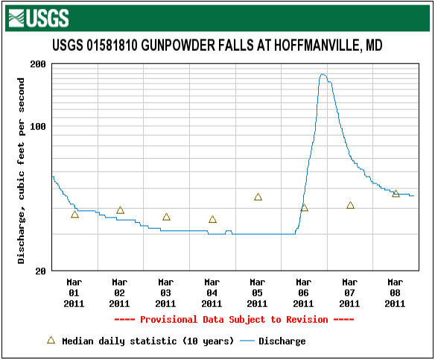
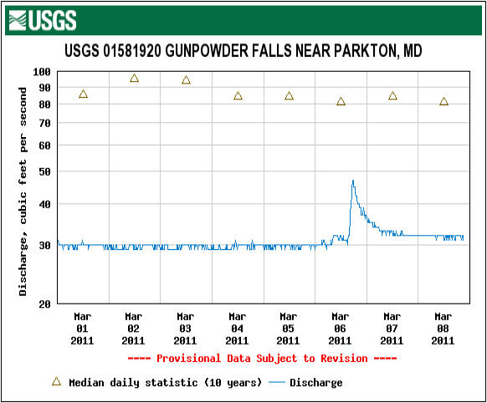
Flow Comparison
Notes:
Prettyboy Reservoir acts as a buffer thus preventing high flow levels that the top GP receives from moving LWD (Large Woody Debris). As a result, clear channels are not created, strainers and the hazards they present are persistent.
March 6. An increase of 150 Cubic Feet per Second above Prettyboy resulted in an 18 Cubic Feet per Secondincrease below.

Slide 47
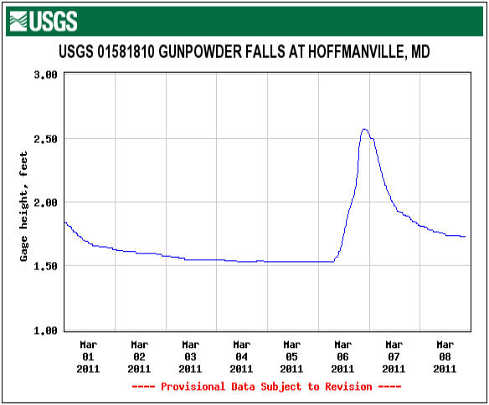
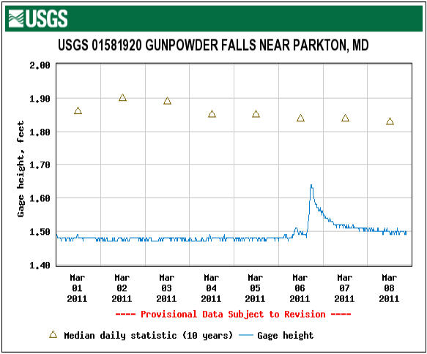
Height Comparison
Notes:
March 6. An increase of 1.0 foot above Prettyboy resulted in an 0.15 foot height increase below.

Slide 48
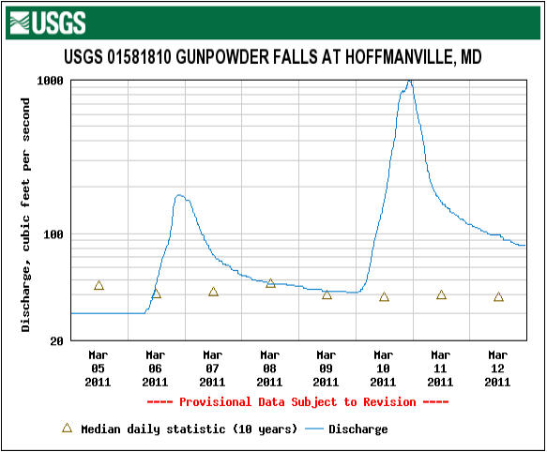
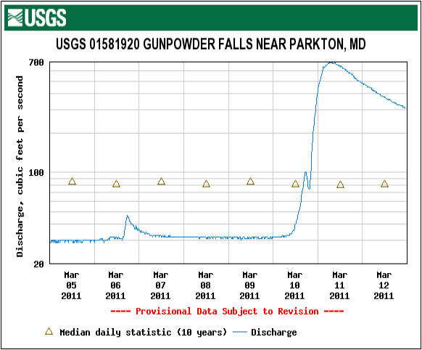
Flow Comparison
March 6 While the flow above Prettyboy was 40 CFS it was only 30 CFS below.
March 11 While the flow above Prettyboy was 1000 CFS it was only 700 CFS below.
Notes:
Prettyboy Reservoir acts as a buffer thus diminishing or preventing high flow levels that the top GP receives from repositioning LWD (Large Woody Debris). As a result, clear channels are not created, strainers and the hazards they present are persistent for greater periods. This means that LWD and the hazards presented may not be cleared naturally for years. Altered flow around and under has caused significant erosion.

Slide 49
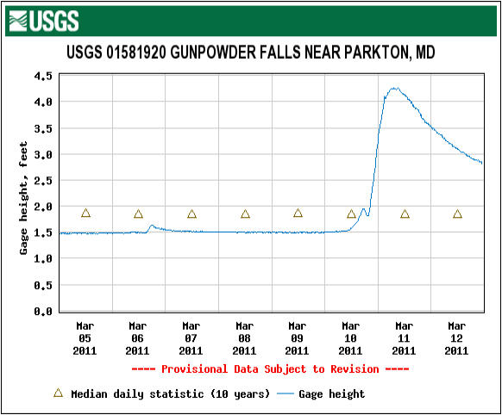
Height Comparison
Notes:
The water finally crested the dam.

Slide 50
American Whitewater Guidelines
Do Not Remove Log More OK to Remove Log
Ecological Considerations
Sand, Gravel, Coble Banks Bedrock Banks
Floodplain Adjacent to Channel Cliffs Adjacent to Channel
Log Trapping Sediment Log Above Water Level
Log is Large and Long Log is Small and Short
Stream has Endangered Species No Endangered Species
No Riparian Vegetation Dense Riparian Vegetation
Heavily Impacted Watershed Intact Forested Watershed
Paddling Considerations
Log is Obvious Log is Hidden
Log is Avoidable While Paddling Log is Unavoidable
Log is Easily Portaged Log is Impossible to Portage
Log Unlikely to Entrap Paddler Log Likely to Entrap Paddler
Log in Seldom Paddled Reach Log in Popular Reach
Class V Class II/III
Wilderness Urban
Notes:
Source: http://www.americanwhitewater.org/archive/article/338
Copied on 03/07/2011
Published 2001
Article:
How Much Wood Does a Paddler Chuck?
By Kevin Colburn
Originally published in the American Whitewater Journal 2001.
http://www.ct.gov/dep/lib/dep/fishing/restoration/largewoodydebrisfactsheet.pdf
Angle Large Woody Debris 20-40 degrees downstream from the bank.

Slide 51
Contact Information
Charles Hihn
18426 Gunpowder Rd
Hampstead, MD 21074
buddyh@hiventures.com
410-374-4164

